Slide 1
COMPUTER ORGANIZATION AND ARCHITECTURE
Dr. Rizwan Khan
Head – Department of Computer Science and Engineering
(An NBA Accredited Program)
ABES Institute of Technology, Ghaziabad

Slide 2
INPUT-OUTPUT ORGANIZATION
Peripheral Devices
Input-Output Interface
Asynchronous Data Transfer
Modes of Transfer
Priority Interrupt
Direct Memory Access
Input-Output Processor
Serial Communication

Slide 3
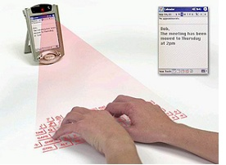
PERIPHERAL DEVICES
Peripheral Devices
Input Devices
Output Devices
Keyboard
Optical input devices
- Card Reader
- Paper Tape Reader
- Bar code reader
- Digitizer
- Optical Mark Reader
Magnetic Input Devices
- Magnetic Stripe Reader
Screen Input Devices
- Touch Screen
- Light Pen
- Mouse
Analog Input Devices
Card Puncher, Paper Tape Puncher
CRT
Printer (Impact, Ink Jet,
Laser, Dot Matrix)
Plotter
Analog
Voice

Slide 4
Input Output Interface
Designing logic circuits (Hardware) and writing instructions (Software) to enable the processor to communicate with peripherals is called interfacing, and the logic circuits are called I/O ports or interfacing devices.
I/O system and I/O module or I/O interface
Each device also has an individual controller that supervises the operation of the particular mechanism in the peripheral

Slide 5
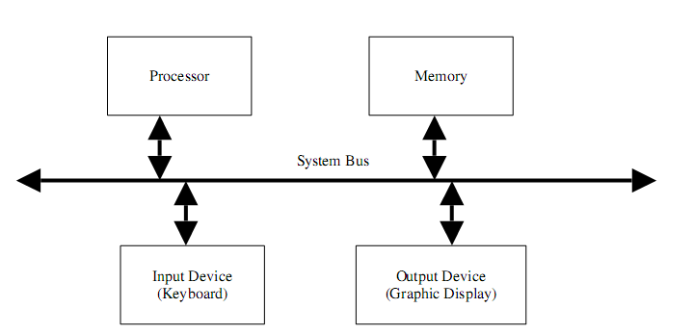
A Single Bus System

Slide 6
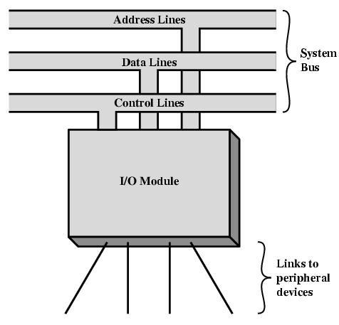
Generic Model of I/O Module

Slide 7
INPUT/OUTPUT INTERFACE
Input/Output Interfaces
Provides a method for transferring information between internal storage (such as memory and CPU registers) and external I/O devices
Resolves the differences between the computer and peripheral devices
Peripherals – Electromechanical/Electromagnetic Devices
CPU or Memory - Electronic Device
Conversion of signal values required
Data Transfer Rate
Peripherals - Usually slower
CPU or Memory - Usually faster than peripherals
Some kinds of Synchronization mechanism may be needed
Unit of Information
Peripherals – Byte, Block, …
CPU or Memory – Word
Data representations and operating modes may differ

Slide 8
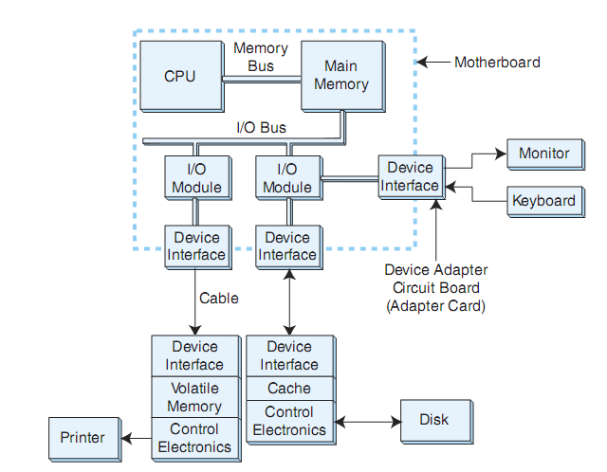

Slide 9
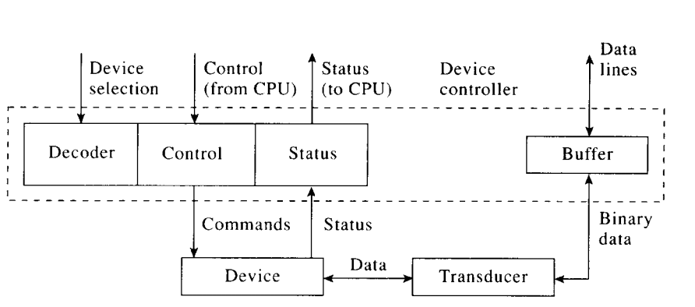
Device Interface

Slide 10


